Slide 1
One10 | Spear Marketing Group
PerformX Integrated Awareness Campaign
April 12, 2023

Slide 2
Brand Position

Slide 3
The Big Idea
The One10’s PerformX SaaS-based incentives and reward platform helps your organization drive sales, retain and acquire talent, and gain market share while reinforcing your unique culture and core values.

Slide 4
Key messages & value props
PerformX is NOT a one-dimensional, out-of-the-box solution. PerformX…
helps companies achieve 2.2 times more sales
empowers improved satisfaction rankings with higher employee engagement levels across positions
fuels retention and acquisition: Your sellers earn more, exceed goals, and have lower turnover rates
rates 56.8% better than our 11 competitors
is highly customizable with program creation capabilities “on the fly”
offers 1:1 customer service
features an accessible and comprehensive eCatalog
offers actionable, graphical reports
is security compliant
has an engine that’s faster and lighter than the competition
PerformX is highly brandable and customizable, featuring white label capabilities.
PerformX…
allows your organization to reflect unique brand image using your logos and colors. Employees see everything as coming directly from you
is highly flexible, allowing you to build incentive and reward programs the way you want based on our proven set of promotion types
offers you the freedom to choose between configurable rules, structures, communications, and award options
reinforces your unique company values and culture through customization
helps you build training programs to enhance greater performance success
PerformX is easy to use. It’s accessible, clean, highly intuitive and straightforward.
PerformX…
offers an exclusive, mobile-first UI.
programs are accessible 24/7, and your team can access information from any device, anywhere, at any time.
offers 1:1 customer service.

Slide 5
Concept overview
The Problem: Rewards and incentives programs are essential to today’s thriving workplace. Companies need to be able to more easily strategize, communicate, execute and measure the success of these programs easily meeting the varied needs and demands of their teams.
Visual Concepts:
Motivation and Retention
Visuals focus on an individual and are meant to convey a sense of gravitas and the importance of using strategic and data-driven programs to retain top performers.
Intersection
Exploring the idea of intersection, and how PerformX has proven, data-driven strategies designed to reward and motivate where those ideas come together. People are happy, and in the smallest ads, can be dropped in favor of color and graphics only.
What Drives Your People?
Representing the top performer (as the person burning the midnight oil), and asking questions of the employer. For a subtle add, when computer screen is visible, could add an image to the computer screen with something that inspires them—an exotic place, a concert, etc.
Individuality
Implying the individuality of the employee, and their varied motivations using a series of triangles that form an X (PerformX). Perform X is able, through data, to respond with highly personalized incentives.

Slide 6
Visual Concepts

Slide 7
Concept 1
Visual Intent: Visuals focus on an individual and are meant to convey a sense of gravitas and the importance of motivating and retaining top performers.

Slide 8


Notes:
300x250
728x90
320x50
160x600
300x600
LI ad with CTA
LP example

Slide 9


Image: Like the eye catching image but the woman looks a little too stressed out. Consider using a different image.
Note will replace or delete image as needed.
Notes:
landing page banner

Slide 10


Slide 11

Not using this one.

Slide 12




Image: Like the eye catching image but the woman looks a little too stressed out. Consider using a different image.
Note will delete or replace backgrounds as needed.

Slide 13


Slide 14




Image: Client mentioned the woman looks like she has too much attitude.
Note will delete or replace backgrounds as needed.

Slide 15
Concept 2
Visual Intent: Exploring the idea of intersection, and how PerformX has proven, data-driven strategies designed to reward and motivate. People are happy, and in the smallest ads, can be dropped in favor of color and graphics only.

Slide 16

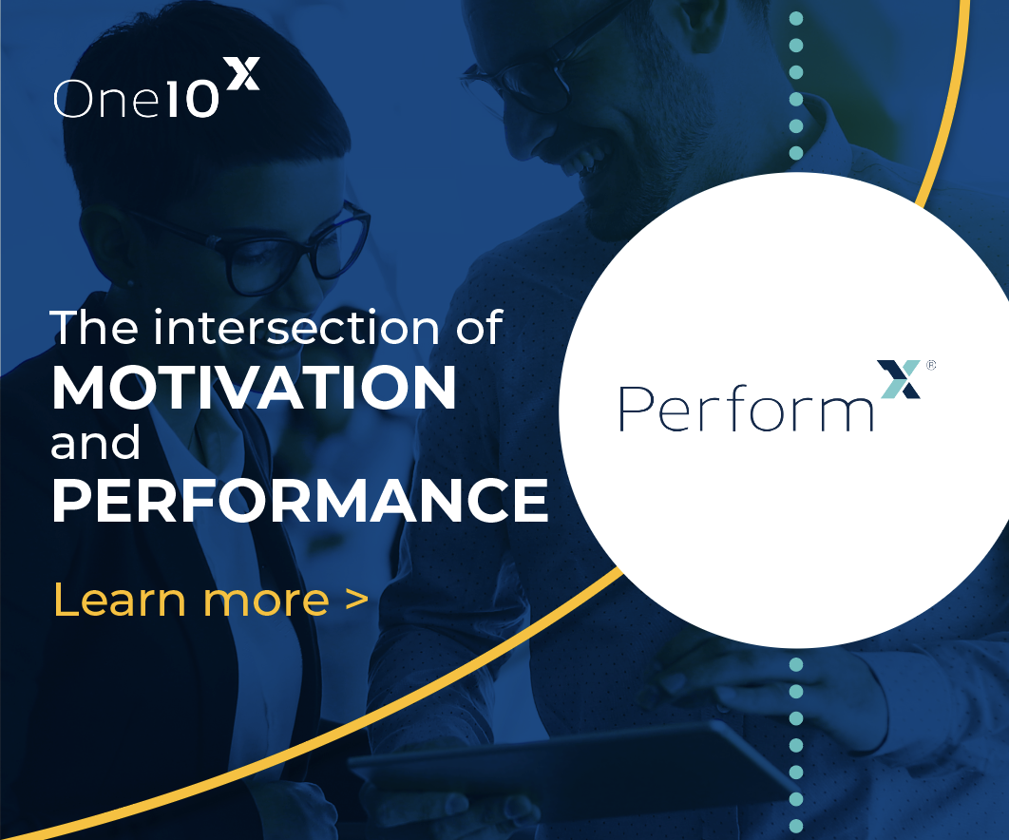
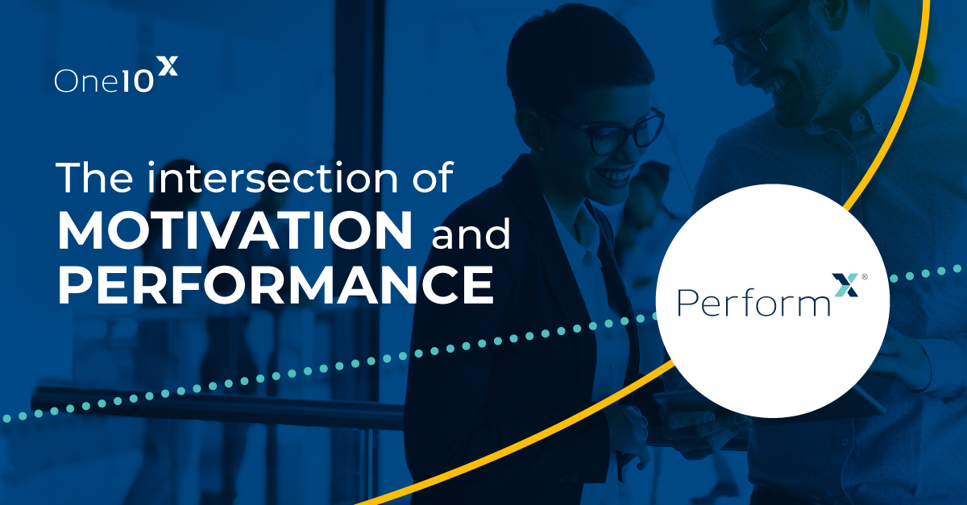
Note: with the smallest ads (300x50 for example), room for 2 logos will be severely limited. The ad shown on the left is 300x250.

Slide 17

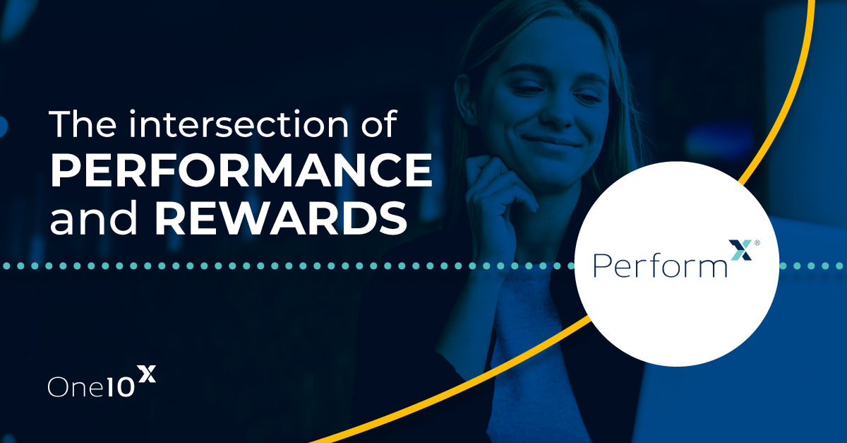

Slide 18


Slide 19
Concept 3
Visual Intent: Representing the top performer (as the person burning the midnight oil), and asking questions of the employer. For a subtle add, when computer screen is visible, could add a picture-in-picture with something that inspires them—an exotic place, a concert, etc.

Slide 20



Slide 21




Slide 22

Send onex stuff
to crystal

Slide 23





Slide 24


Slide 25
Concept 4
Visual Intent: Implying the individuality of the employee, and their varied motivations using a series of triangles that form an X (PerformX). Perform X is able, through data, to respond with highly personalized incentives.

Slide 26


Slide 27
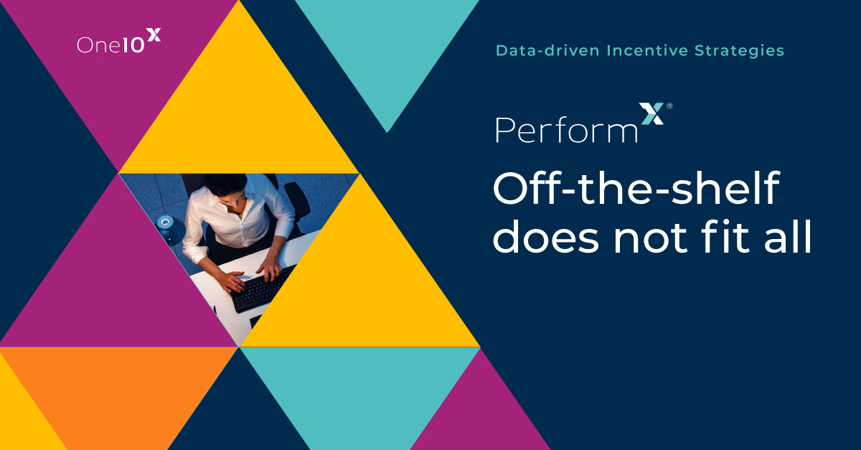

Slide 28


Slide 29
Appendix

Slide 30
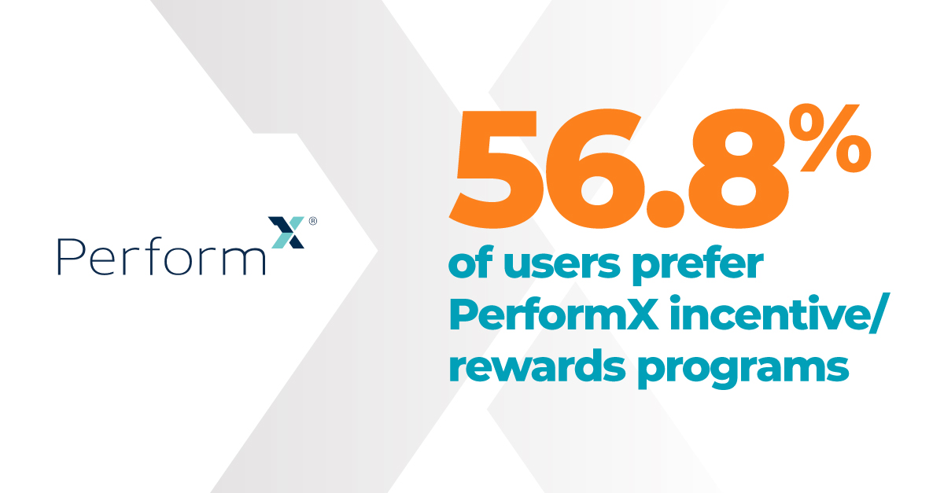
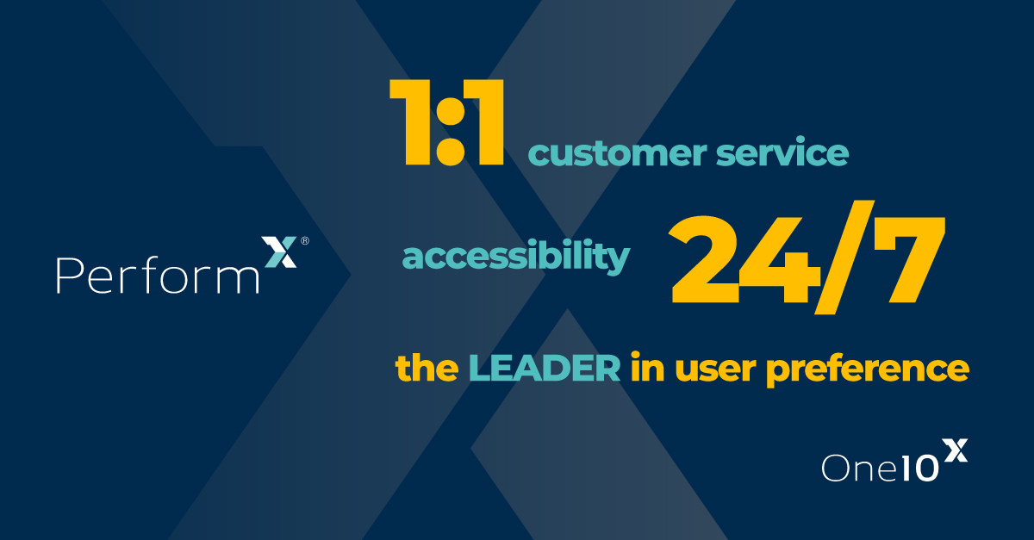
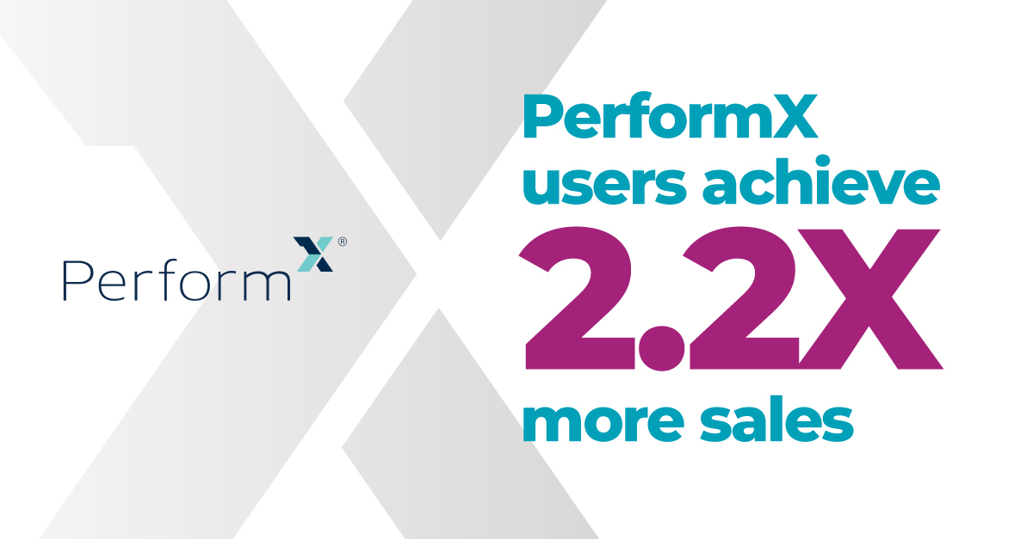
Note: Compelling stats are impactful—strongest here is the 2.2X.

Slide 31
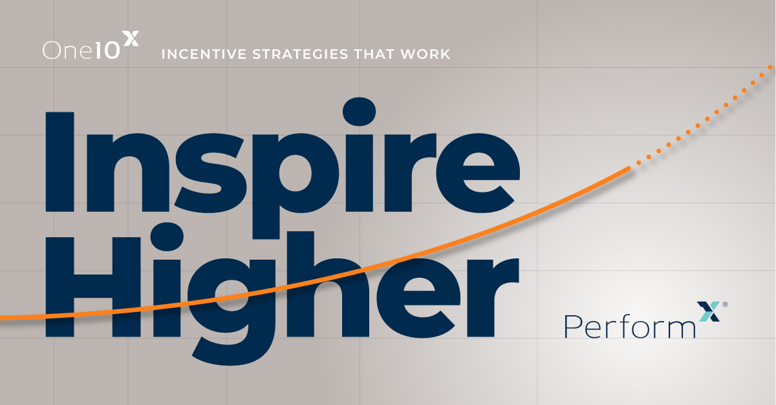
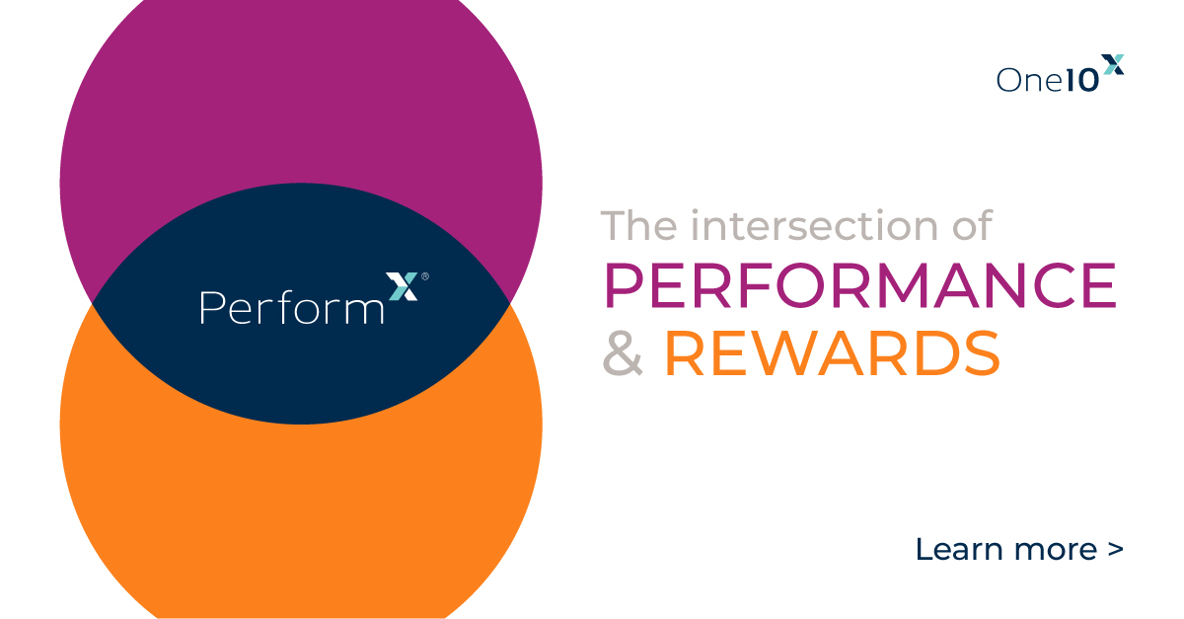
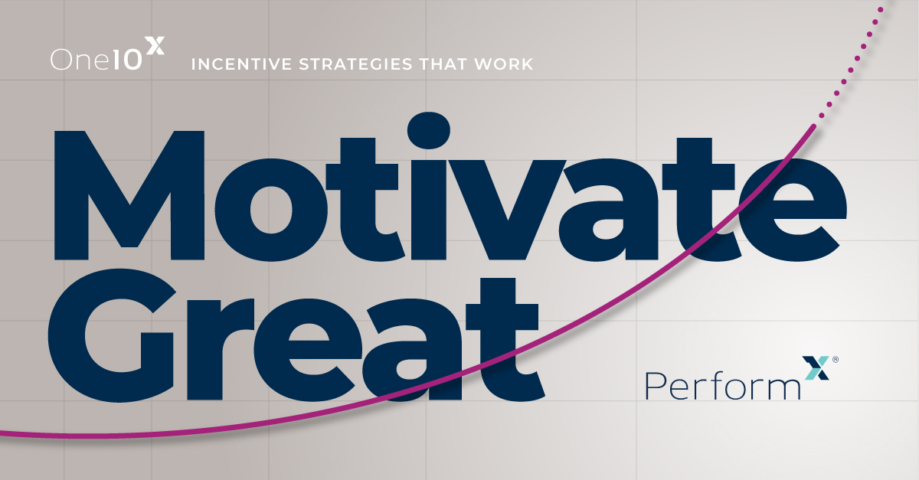

Slide 32
Court Patton, Creative Director I court@spearmarketing.com
Annette Gallagher, Associate Creative Director| annette@spearmarketing.com
Mary Pat Davey, Sr. Account Manager | marypat@spearmarketing.com
Lynn Dodds, VP Creative Services | lynn@spearmarketing.com
Mariana Prieto, Sr. Account Manager | mariana@spearmarketing.com
Annie Silva, Group Account Director | annie@spearmarketing.com

